Slide 1
MEEN 433/667 Project
By:
Sebastian Villa Cuellar
Logan Morris
Alan Gregory

Slide 2
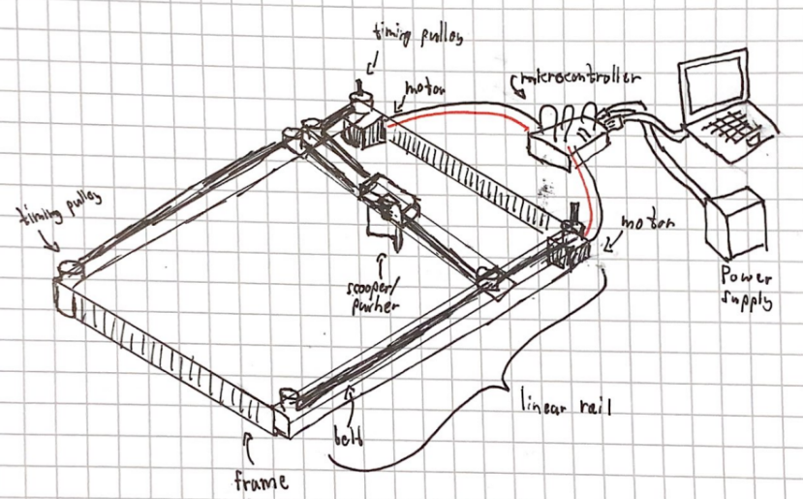
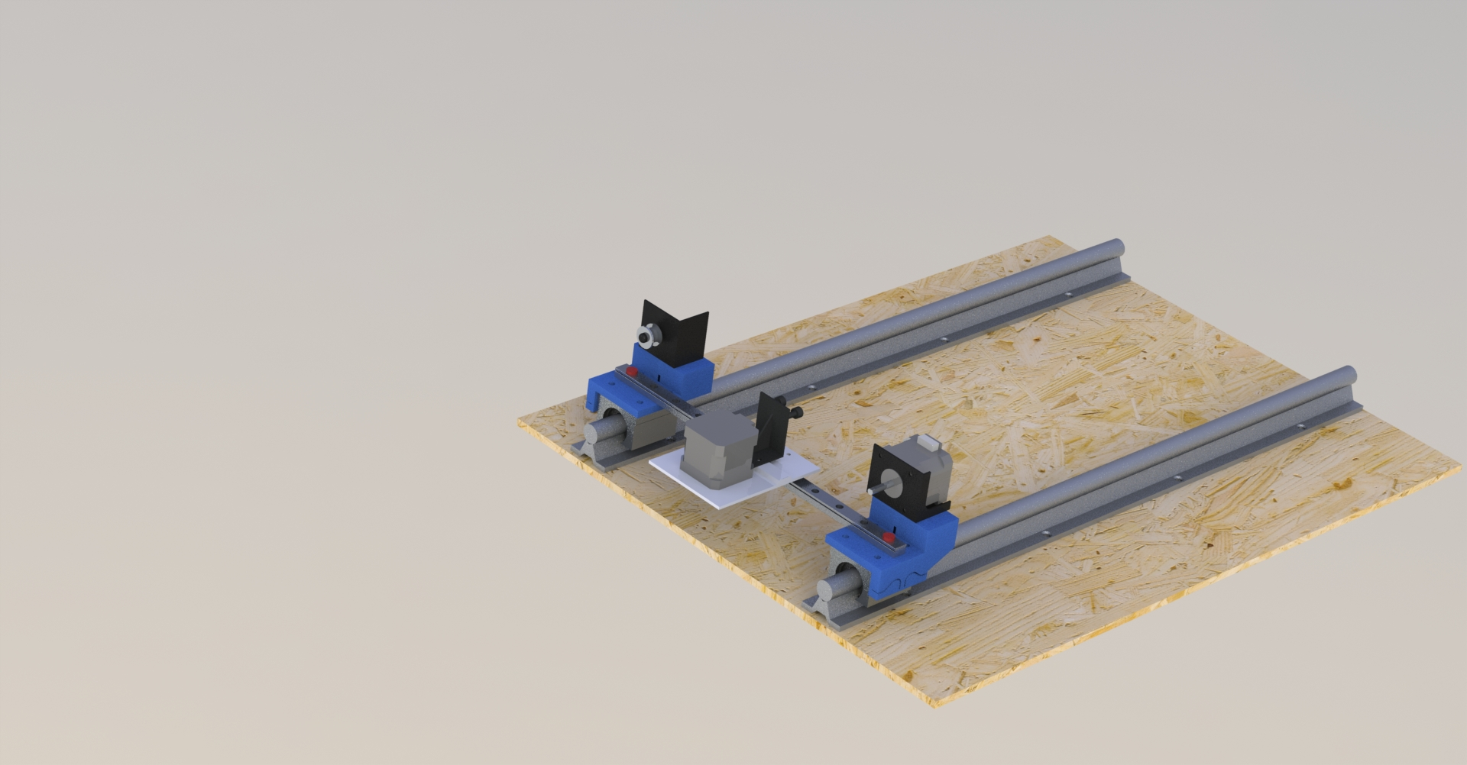
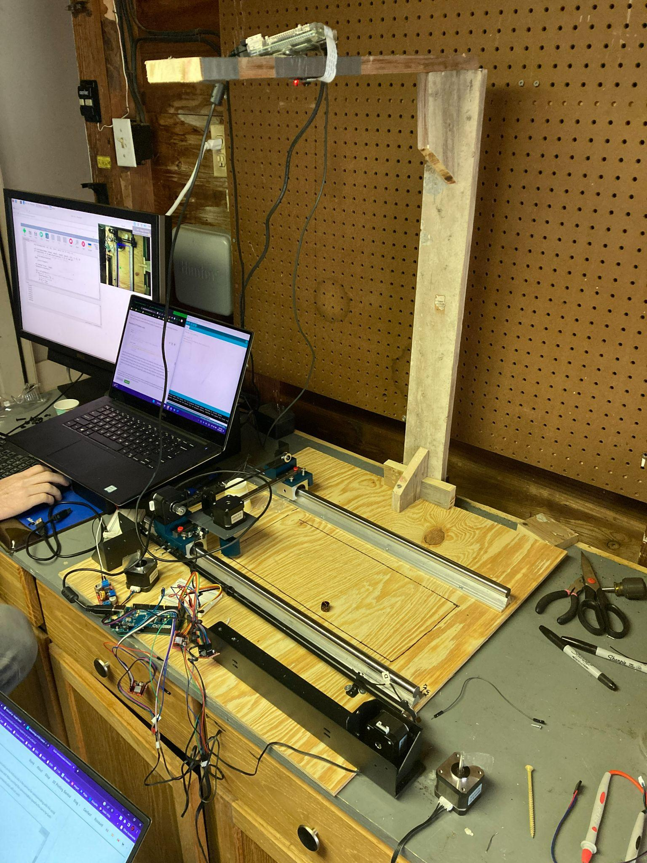
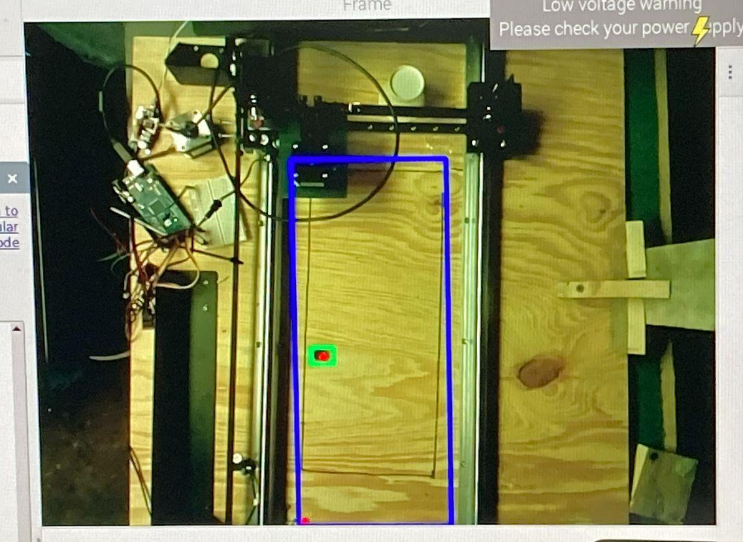
Agenda
The Idea
The Proposal
The Progress
The Final Product and How it Works
Feel free to ask questions at any time!

Slide 3
The Idea

Slide 4
The Proposal

Slide 5
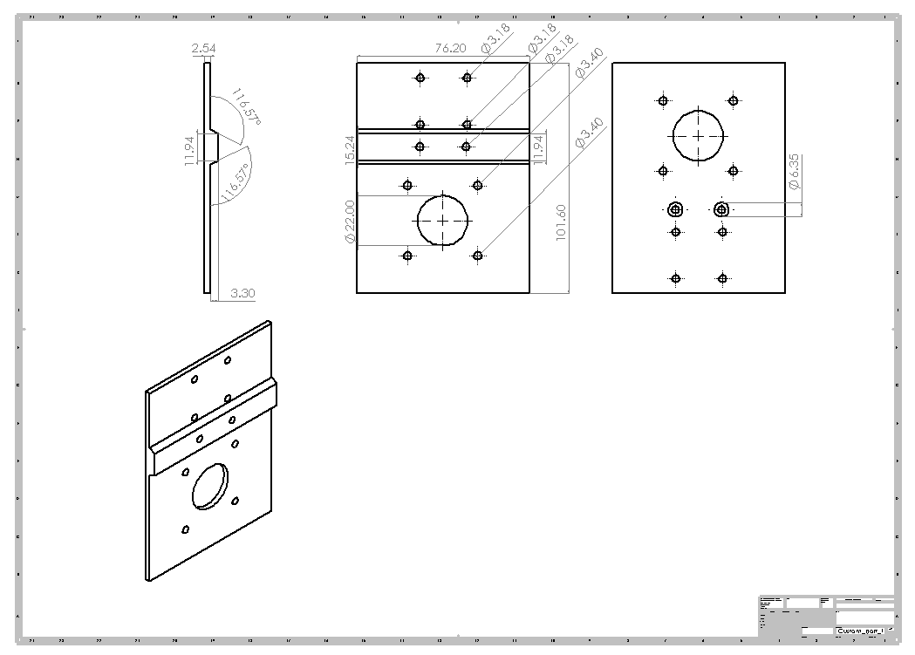
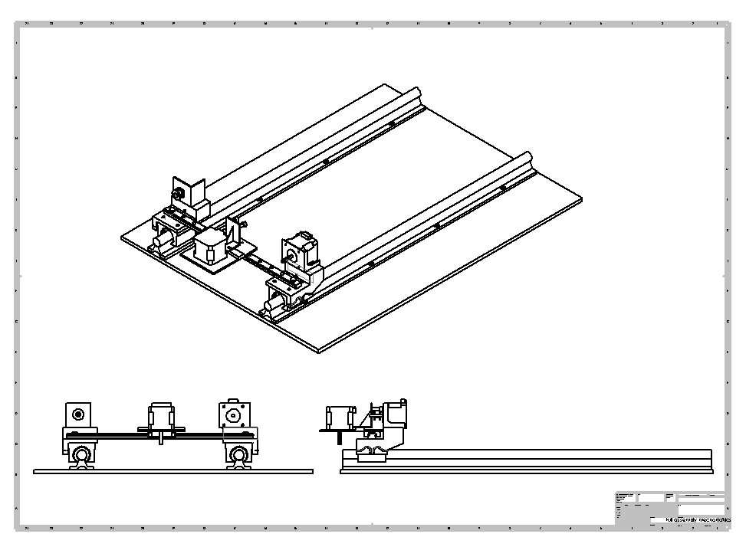
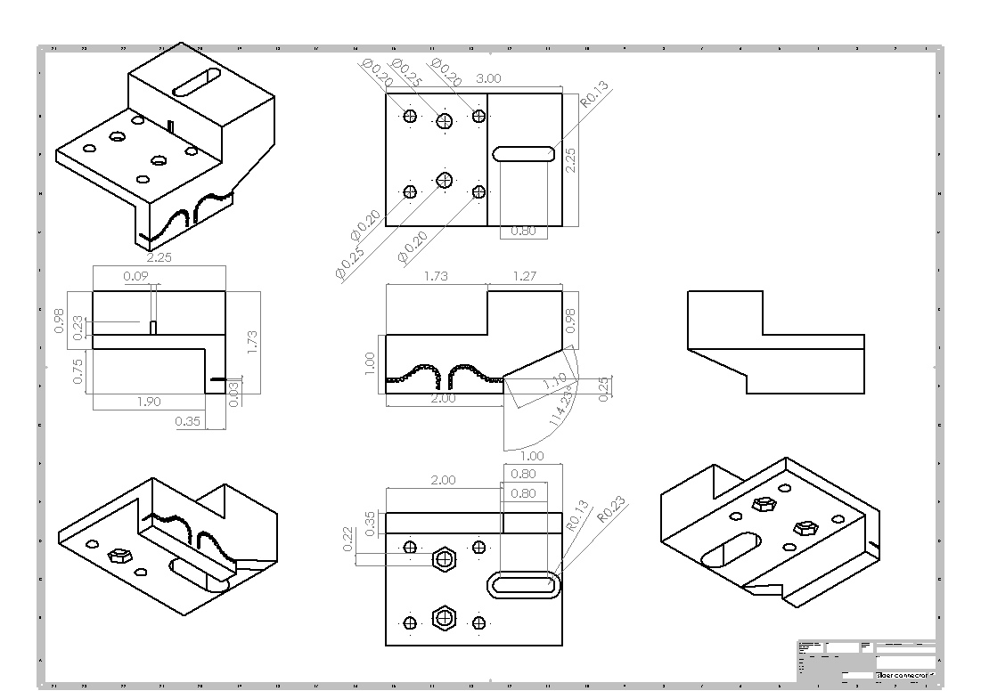
The Progress

Slide 6
The Final Product

Slide 7
How it works!
Detection
Target Acquired
Approach the Object
Push the Object
Return to Origin

